Slide 1
NetBox Extensibility Overview
NetBox Day, May 19th
John Anderson, Principal Consultant
NetBox Maintainer

Slide 2
Agenda
NetBox extensibility landscape
Use cases and options

Slide 3
What is Extensibility?
Core features that allow users to enhance NetBox
Allow teams to better integrate NetBox into their workflows and organization at large
Many of these features become necessities for automation

Slide 4
Do I need to be a developer?
NAPALM
Custom Fields
Custom Links
Webhooks
Export Templates
REST API
Reports
Custom Scripts
Plugins Framework
Expertise

Slide 5
NAPALM
Integration with the NAPALM python library
Device status & configuration
Interface connection LLDP neighbors
REST API for any get_* methods
https://github.com/napalm-automation/napalm

Slide 6
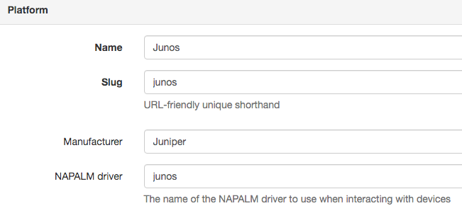
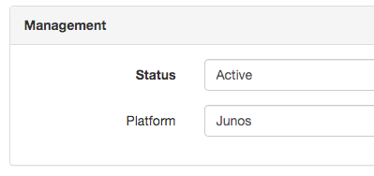
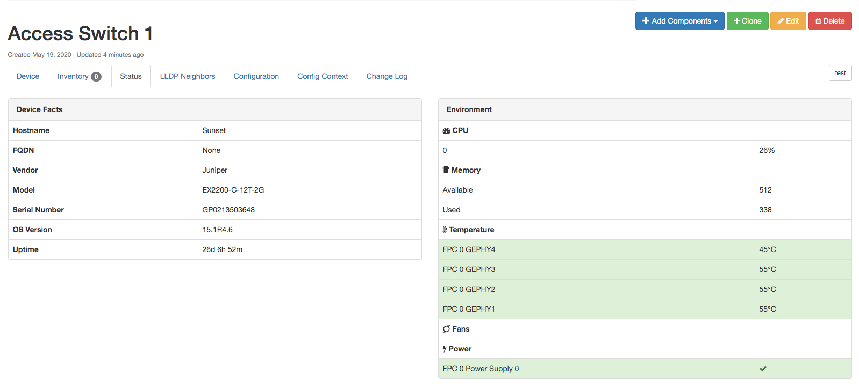

2. Create Platform and specify NAPALM driver name
Install napalm and provide credentials in configuration.py
$ pip install napalm
$ grep NAPALM configuration.py
NAPALM_USERNAME = "juniper"
NAPALM_PASSWORD = "juniper123"
3. Assign Platform to Device with primary IP set
4. Access NAPALM related tabs like Status

Slide 7
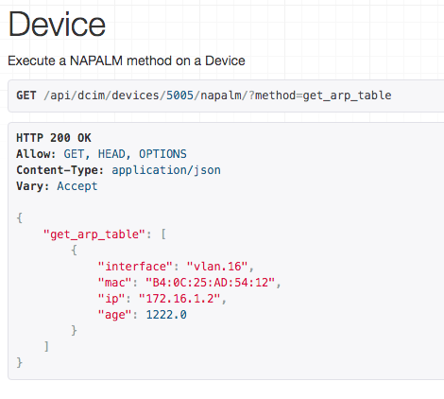
NAPALM REST API Proxy

Slide 8
Custom Fields
User defined fields added to primary models
Used when you need to store some bit of data on all devices, sites, etc.
Bridges the gap between your use case and one that not all users need
Text, integer, boolean, date, URL, selection
Feature parity in the Web UI and REST API

Slide 9
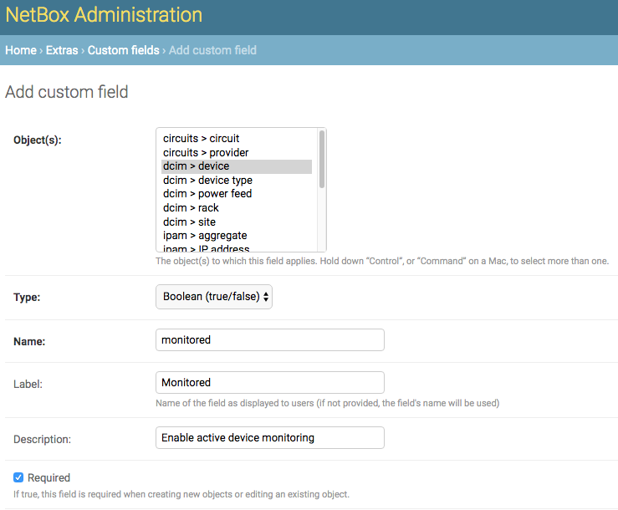
Custom fields are created in the NetBox admin portal.
Select the primary object type(s) the field will apply to, the field type, and give it a name.

Slide 10
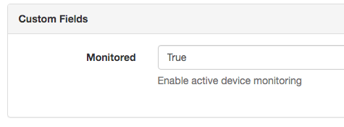
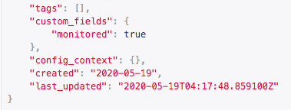

Custom fields are included in the object form when creating/editing items.
Custom fields are natively supported in the REST API for both read and write.
They are then displayed on the object’s detail page.

Slide 11
Custom Links
Dynamically generated link buttons (URLs)
Links are templated by accessing attributes of a primary object
Great for linking NetBox data directly to other systems

Slide 12
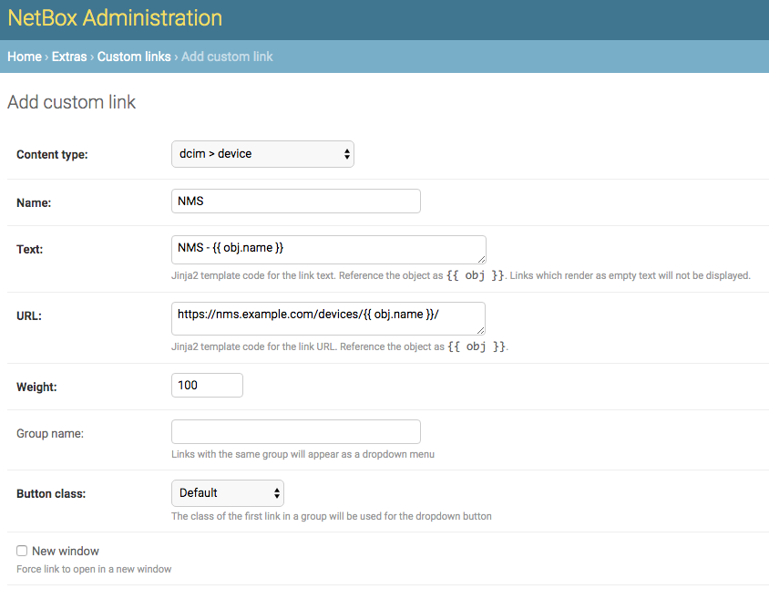
Custom links are created in the NetBox admin portal.
Select the primary object type the link will apply to, then specify a template to generate the link text and the URL.
Templates are created using Jinja2.

Slide 13
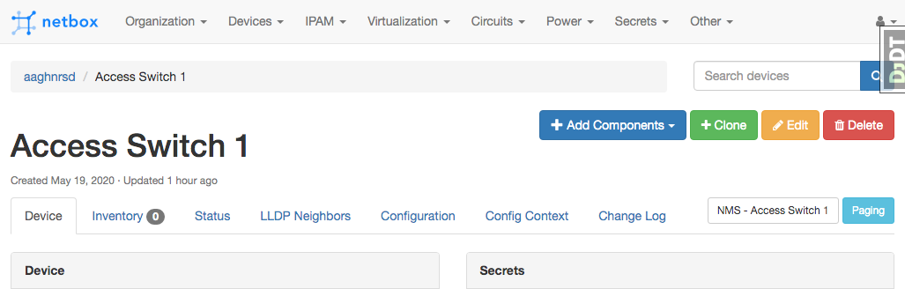

Slide 14
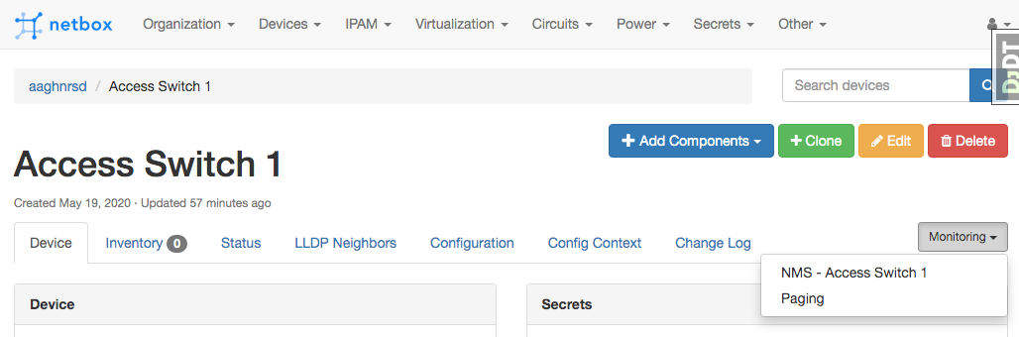

Slide 15
Webhooks
Send event data from NetBox to external systems via HTTP requests
Triggered on object create, update, and delete events
Great for updating/notifying other systems of live events in NetBox

Slide 16
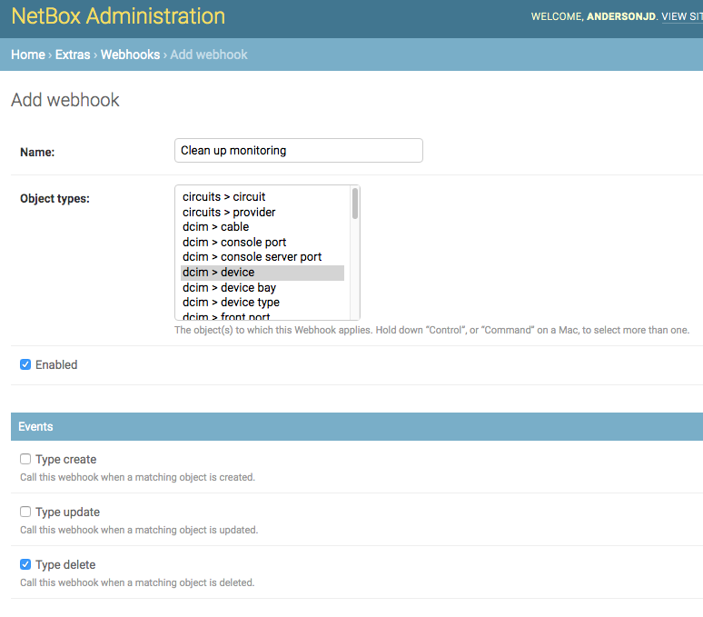
Like the other features, Webhooks are also managed in the admin portal.
Here we specify the object type(s) and the action(s) to which we want to register this webhook.

Slide 17
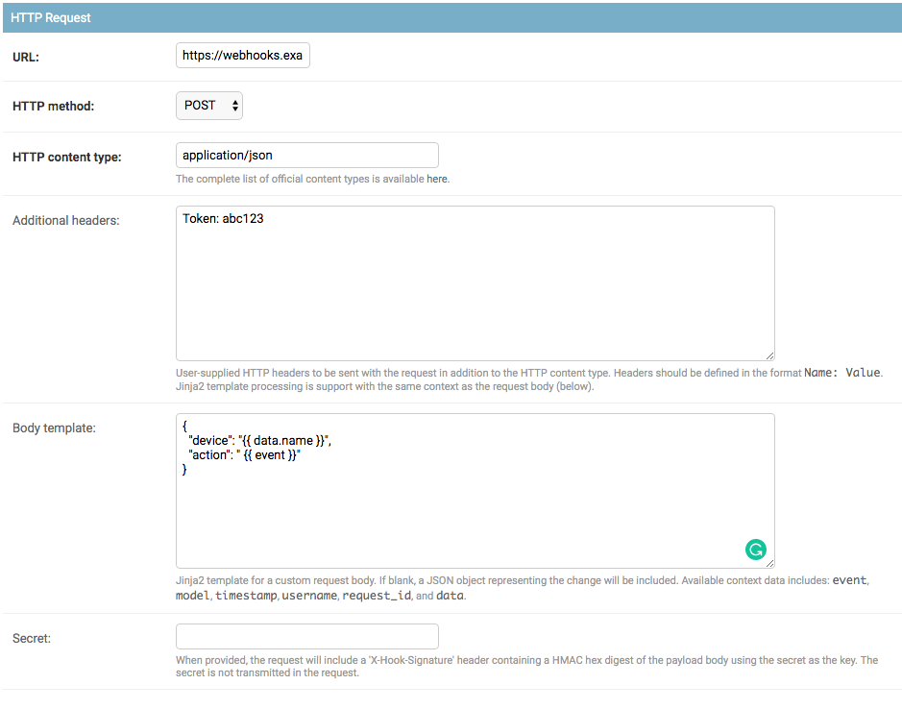
We also need to specify where and how to send the HTTP request.
Webhooks can optionally define user specified HTTP headers and the actual request body.
Both are templated using Jinja2, like before.

Slide 18
Export Templates
Render custom representations of objects
Great for custom CSV exports or generating 3rd party system configurations

Slide 19
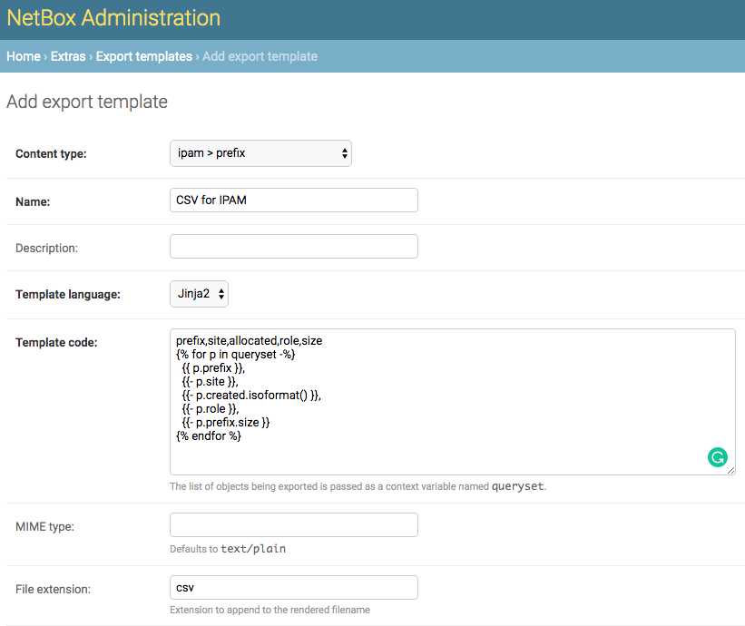
Export templates are written in Jinja2 and you can define a specific MIME type and file extension.
The basic operation of an export template is to loop through a list a objects and arrange the data in some defined format.

Slide 20
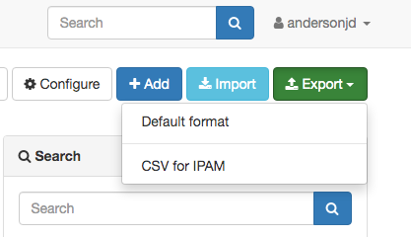
Export templates are listed under Export on each object type’s List view
prefix,site,allocated,role,size
5.101.96.0/21,AMS2,2016-06-22,Customer,2048
5.101.104.0/22,AMS2,2016-06-22,Customer,1024
10.27.0.0/16,AMS2,2016-06-22,HV Management,65536
10.86.0.0/15,AMS2,2017-10-24,Underlay,131072
10.86.0.0/18,AMS2,2017-10-31,Underlay,16384
10.86.0.0/20,AMS2,2017-10-31,Infrastructure,4096
10.86.0.0/23,AMS2,2017-11-01,Infrastructure,512
...

Slide 21
REST API
Perhaps the “bread and butter” of automation use cases
Read and write data to and from NetBox
Several client libraries, or raw HTTP

Slide 22
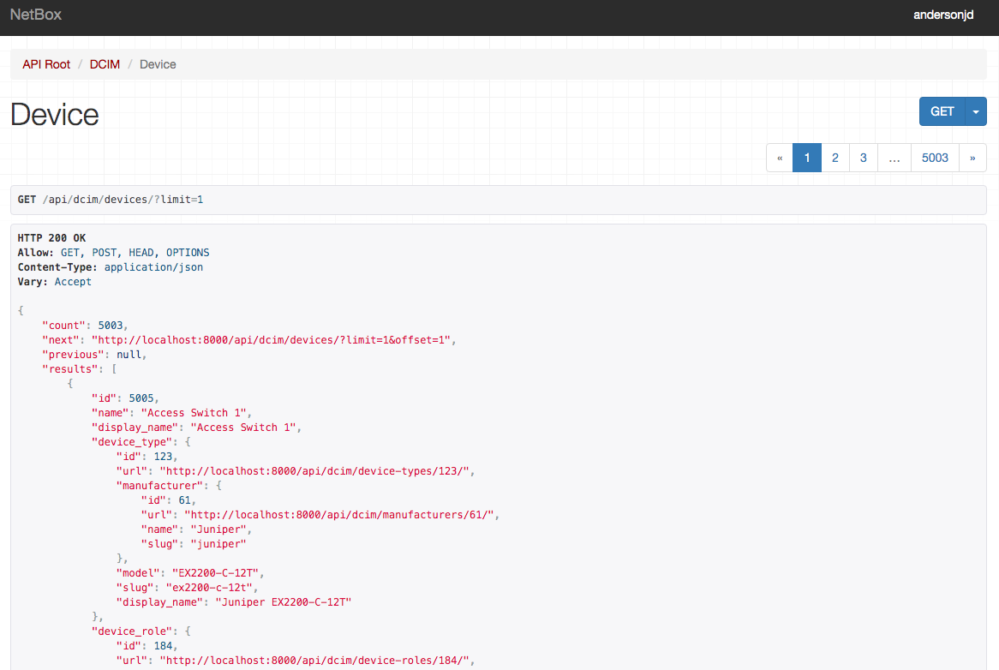
Browsable API
Nice for quickly checking API endpoints/filters.
Generally you can prepend a Web UI URL with /api/ to see the data in the browsable API.

Slide 23
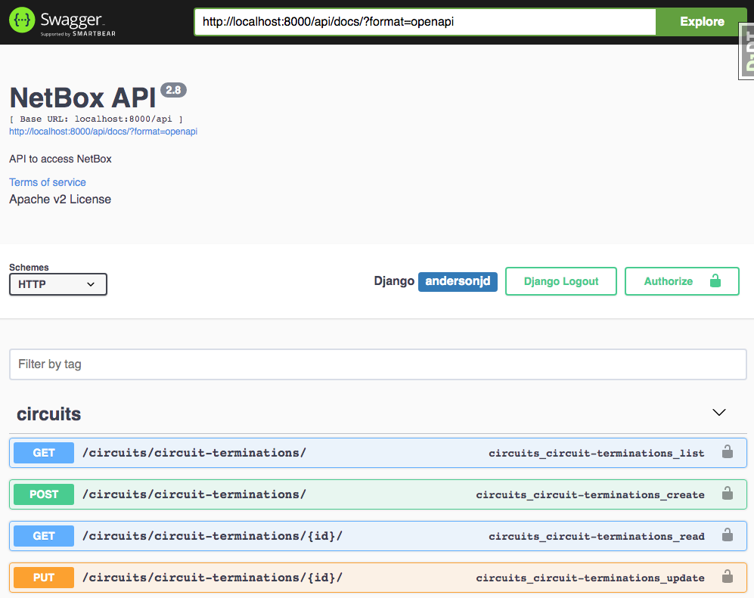
Swagger UI is also available at
http://netbox/api/docs/

Slide 24
REST API - Clients
pynetbox - Python
https://github.com/digitalocean/pynetbox
go-netbox - Go
https://github.com/netbox-community/go-netbox

Slide 25
Reports
User created Python scripts which validate data in NetBox
Reports API provides the “boilerplate” to execute a script
Reports log the success or failure of objects against the validation

Slide 26
import re
from dcim.models import Device
from extras.reports import Report
class DeviceHostnameReport(Report):
description = "Verify each device conforms to naming convention"
def test_devices_at_lax(self):
for device in Device.objects.filter(site__name='LAX'):
if re.match(r'lax-(core|access)-\d\d', device.name):
self.log_success(device)
else:
self.log_failure(device, "Hostname does not conform to standard!")

Slide 27
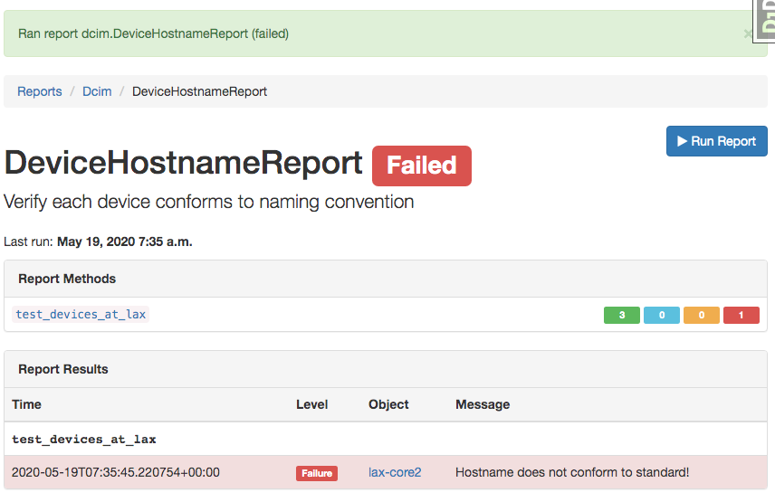
Report results indicate a summary of the execution and list all objects that fail.
Reports may also be executed from the REST API.

Slide 28
Custom Scripts
User created Python scripts that perform generic actions
Very similar to reports, but they accept user input
Great for exerting business logic within NetBox

Slide 29
from django.utils.text import slugify
from dcim.choices import DeviceStatusChoices, SiteStatusChoices
from dcim.models import Device, DeviceRole, DeviceType, Site
from extras.scripts import *
class NewBranchScript(Script):
class Meta:
name = "New Branch"
description = "Provision a new branch site"
field_order = ['site_name', 'switch_count']
site_name = StringVar(description="Name of the new site")
switch_count = IntegerVar(description="Number of access switches to create")
def run(self, data, commit):
# Create the new site
site = Site(name=data['site_name'], slug=slugify(data['site_name']), status=SiteStatusChoices.STATUS_PLANNED)
site.save()
self.log_success("Created new site: {}".format(site))
# Create access switches
switch_role = DeviceRole.objects.get(name='Access Switch')
for i in range(1, data['switch_count'] + 1):
switch = Device(
device_type=DeviceType.objects.get(model='Catalyst 3560X-48T'),
name='{}-switch{}'.format(site.slug, i),
site=site,
status=DeviceStatusChoices.STATUS_PLANNED,
device_role=switch_role
)
switch.save()
self.log_success("Created new switch: {}".format(switch))

Slide 30
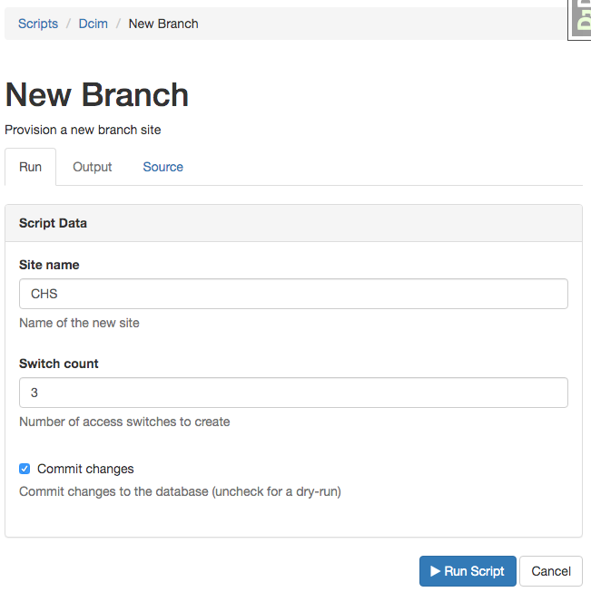
Scripts take user input bounded by the variables defined in the script.
Those input types can include:
String
Text
Integer
Boolean
Choice
Object (reference existing data in NetBox)
File
IP Address
IP Network

Slide 31
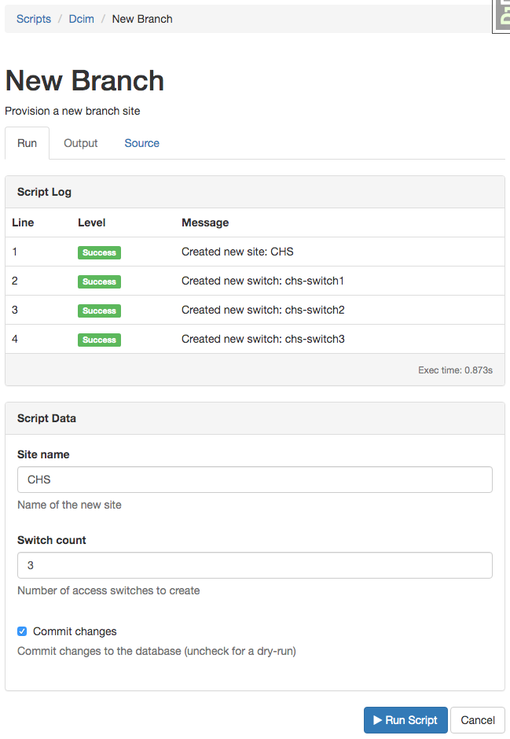
Scripts run inside an atomic database transaction and can easily be rolled back during execution.
Scripts include a log much like Reports and also allow for direct output of data, such as a CSV or YAML.

Slide 32
import re
from dcim.models import Device, Site
from extras.reports import Report
from utilities.forms import APISelect
class DeviceHostnameReport(Script):
class Meta:
name = "Naming Convention Check"
description = "Verify each device conforms to naming convention"
field_order = ['site']
site = ObjectVar(
description="Site",
queryset = Site.objects.all(),
widget=APISelect()
)
def run(self, data, commit):
for device in Device.objects.filter(site=data['site']):
if re.match(r'lax-(core|access)-\d\d', device.name):
self.log_success(device)
else:
self.log_failure(f"{device} Hostname does not conform to standard!")

Slide 33
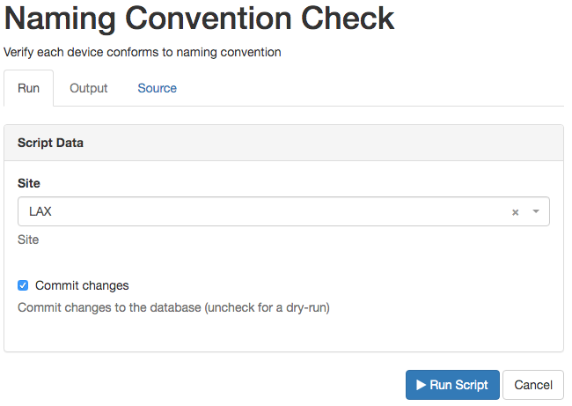
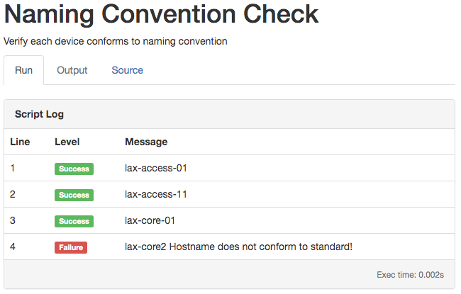

Slide 34
Plugins Framework
Developer centric toolkit for creating NetBox plugins
Launched as a part of v2.8.0
Allows packaging of entirely new functionality that sits on top of NetBox
Can create new models, views, APIs, etc
Can extend existing primary object views

Slide 35
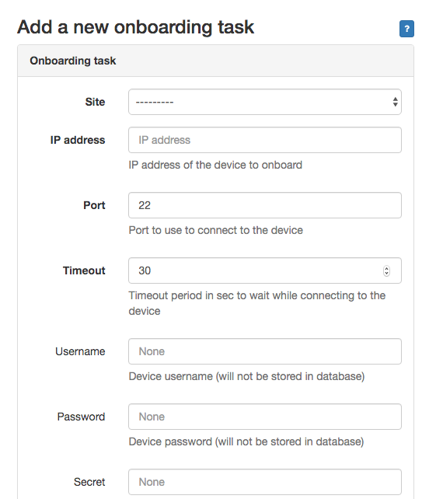
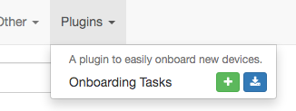
Plugins can add Web UI menu items, forms, views, etc.

Slide 36
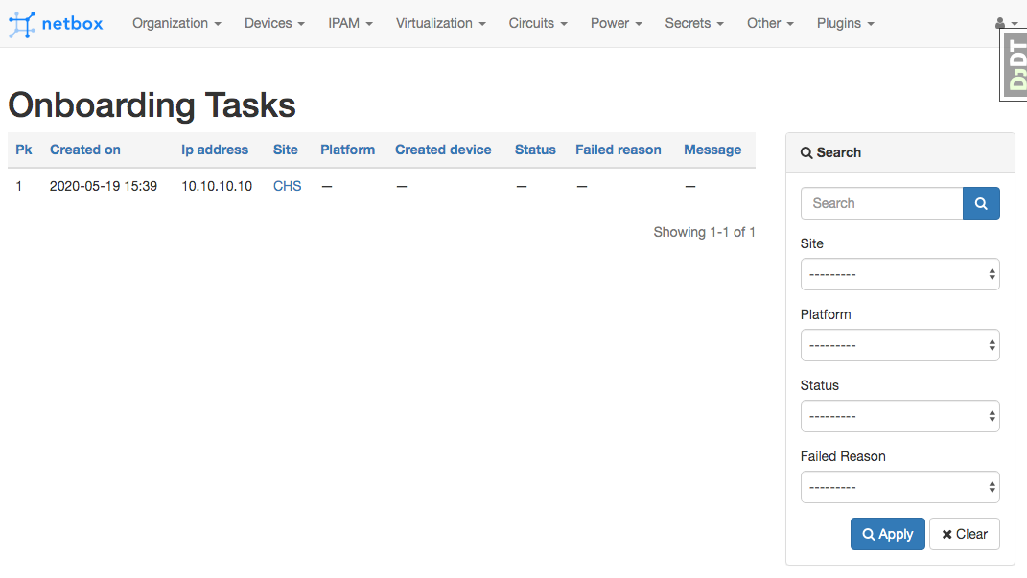

Slide 37
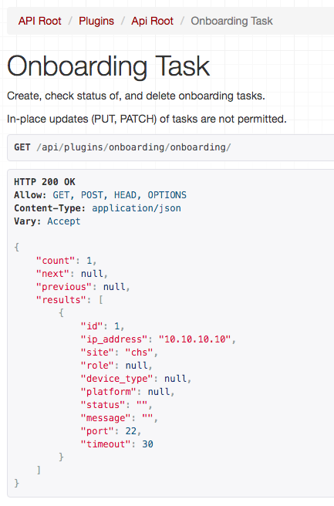
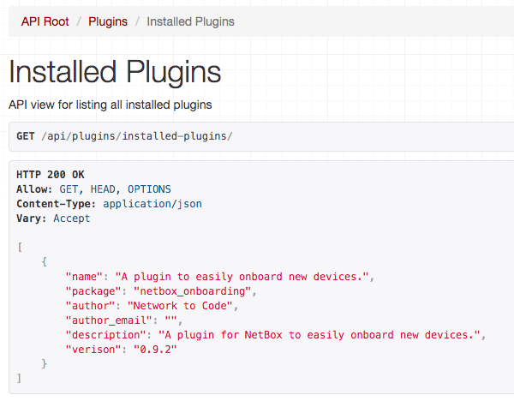
Plugins also support their own namespaced REST APIs

Slide 38
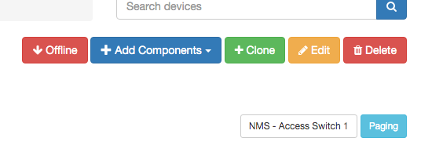
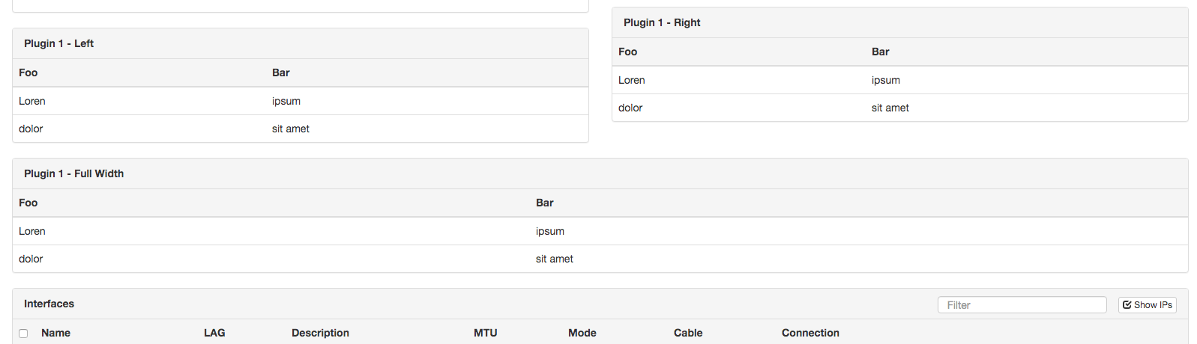
Plugins can inject content into existing, core model pages, including buttons.

Slide 39
Plugins Framework - A New Frontier
The NetBox community is very excited about the opportunities that plugins will create.
Network to Code would love to partner with you to make your plugin ideas a reality!

Slide 40
Thank you!
NetBox Day, May 19th
John Anderson, Principal Consultant
NetBox Maintainer

